Slide 1
A Spectacular Adventure by
David McAllister and Eric Cheng

Slide 2

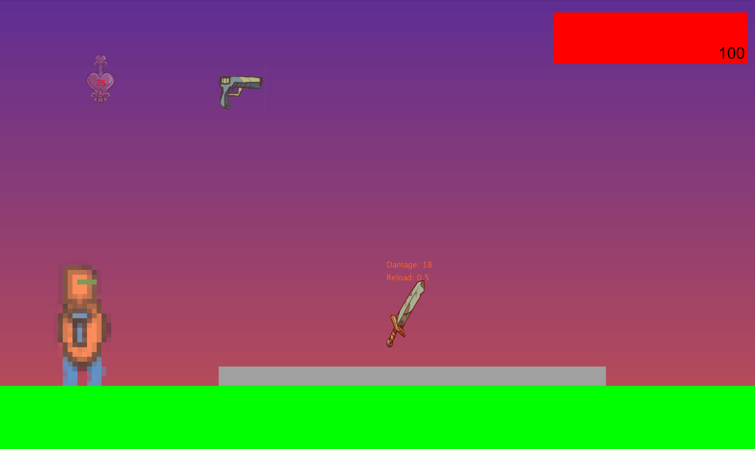
Introduction
Single Player Action Platformer
Uses 2D Physics Engine
Simple, Approachable Controls
Side-Scrolling Perspective
Cures Boredom
Rick the Robot

Slide 3
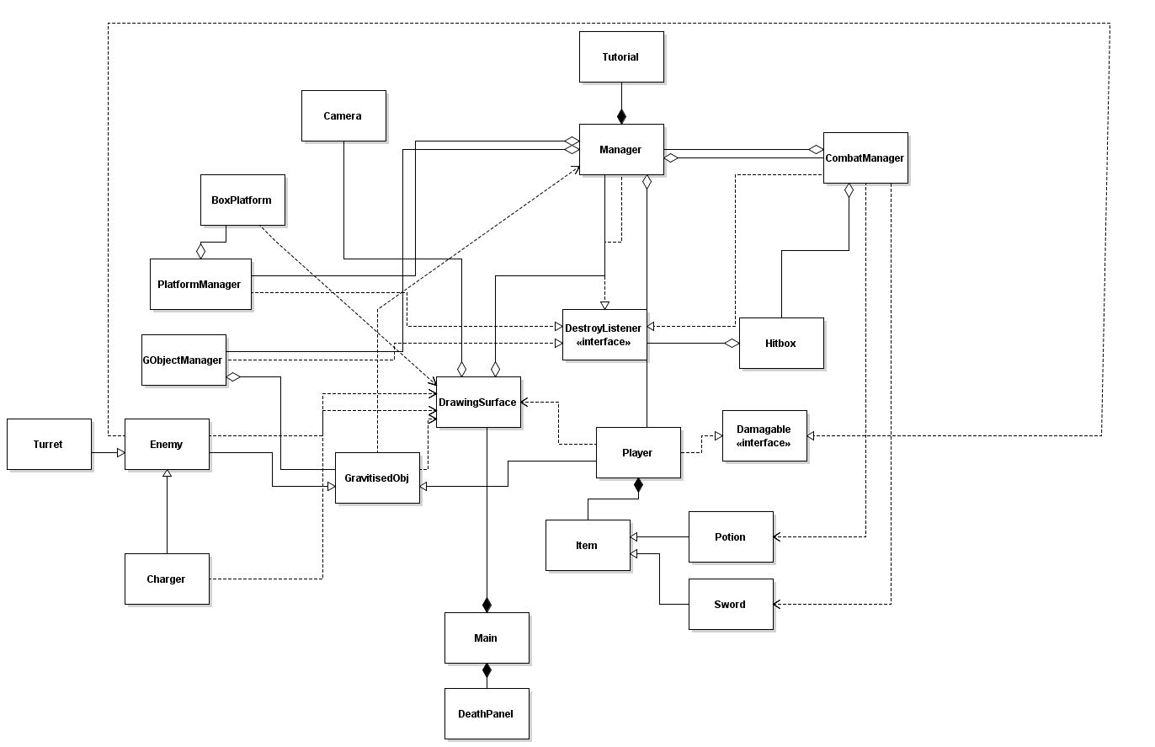
Code Overview

Slide 4
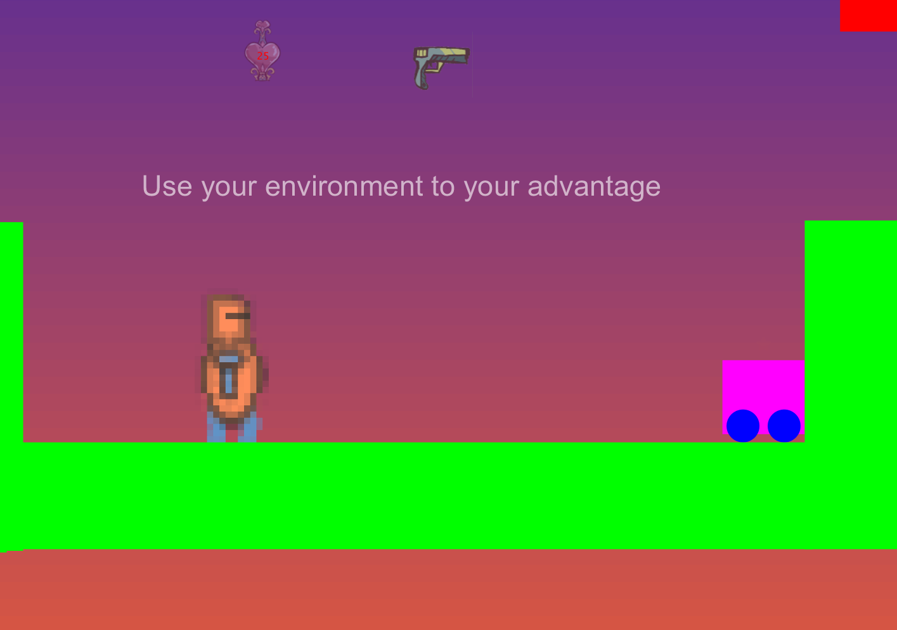
Challenges
Interactions Between Objects
Hitboxes
Environment
Enemies
Solid Physics
Gravity Feels Natural
Collisions Predictable
Speed With Many Platforms

Slide 5
Code Design
Managers Handle Interactions
GObjectManager
PlatformManager
CombatManager
General Manager

Slide 6
Let’s Play
Bugs
Charger Enemy Sometimes Goes Into Wall
Multiple Hits Can Sometimes Trigger in Fringe Cases
Controls
WASD to Move
Scroll to Change Item
Spacebar to Use Item

Slide 7
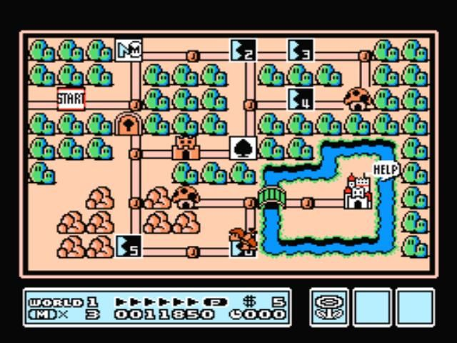
Future Improvements
Build On Current Framework
More Levels
Increased Enemy Diversity
Infinite Runner Mode
Add Textures For Environment

